Slide 1
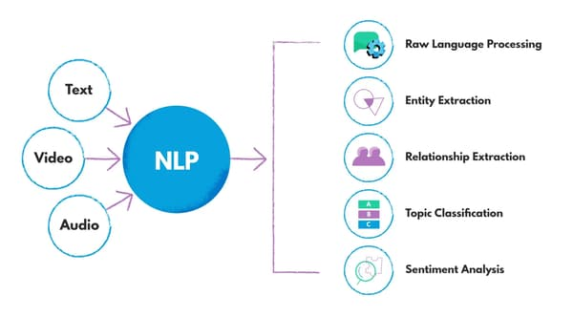
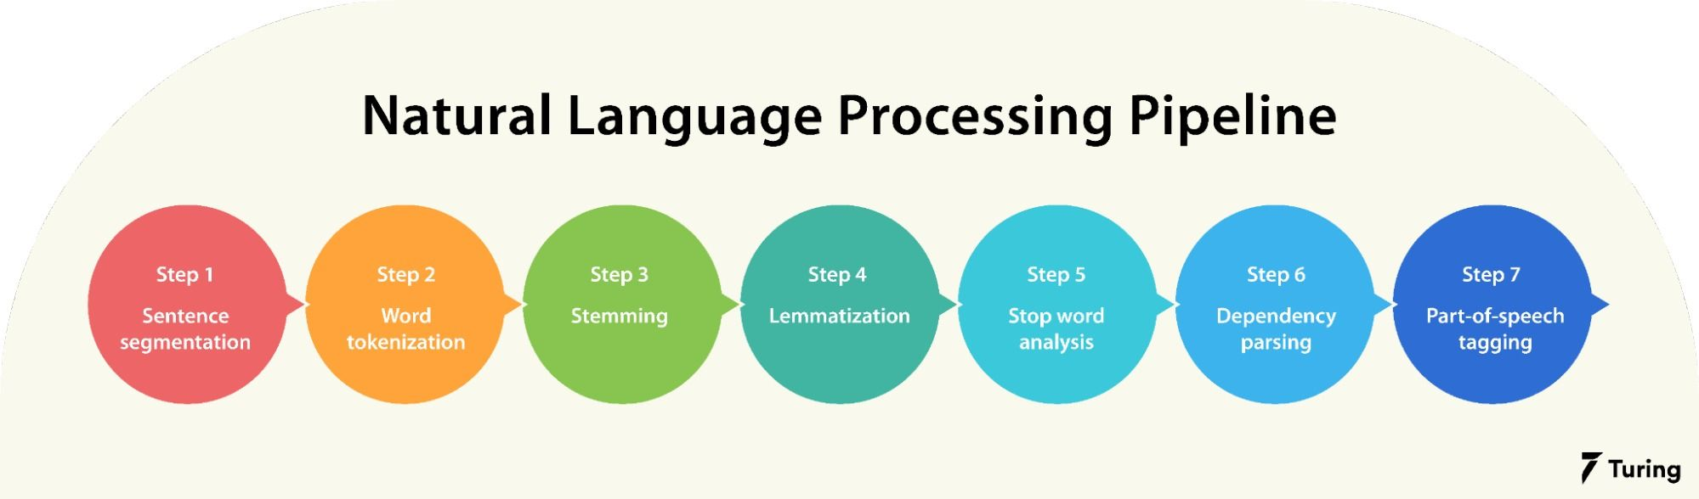
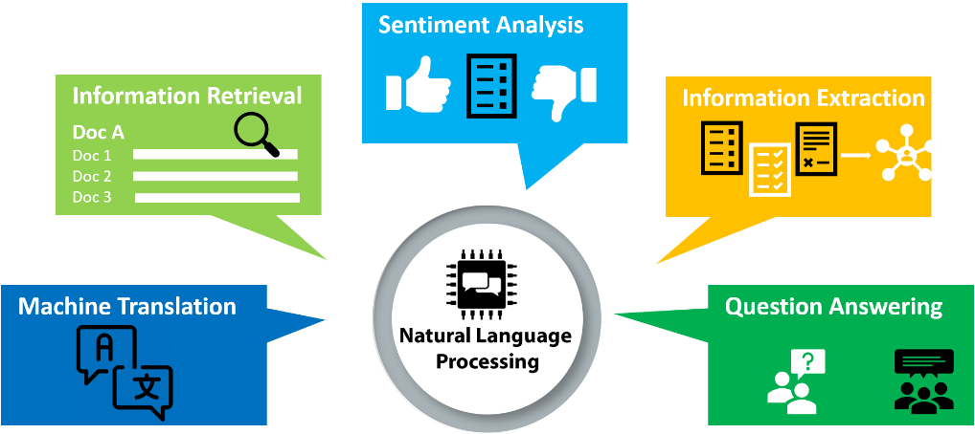
NLP and its Applications

Slide 2
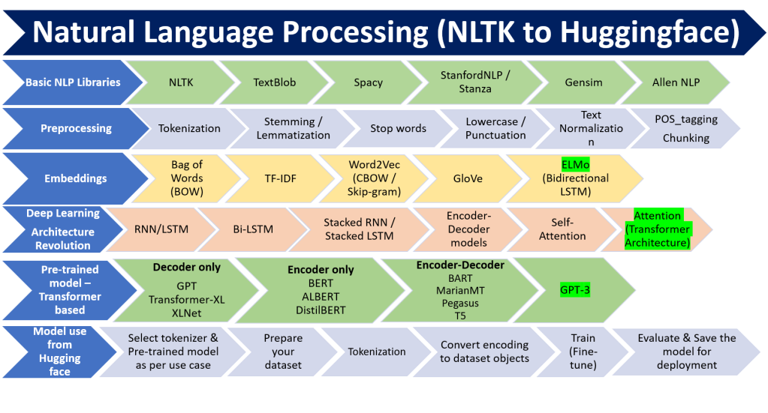
Evolution of NLP

Slide 3
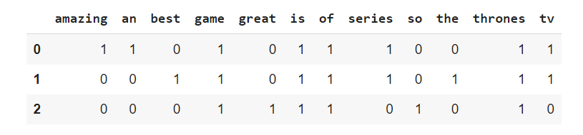
Bag of Words(BOW)
Example
Statement 1: Game of Thrones is an amazing tv series!
Statement 2: Game of Thrones is the best tv series!
Statement 3: Game of Thrones is so great

Slide 4
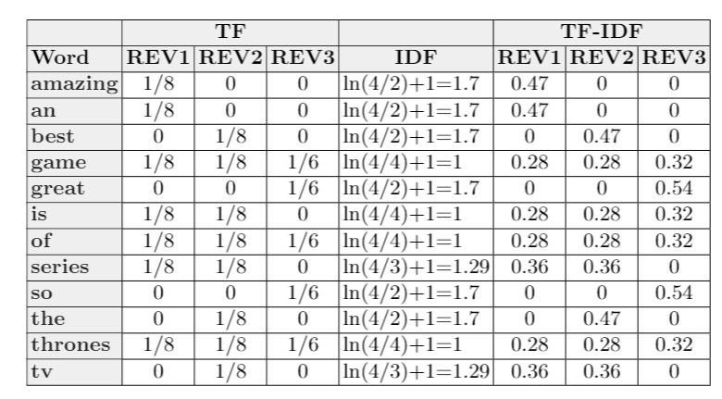
TD-IDF
Statement 1: Game of Thrones is an amazing TV series!
Statement 2: Game of Thrones is the best TV series!
Statement 3: Game of Thrones is so great.

Slide 5
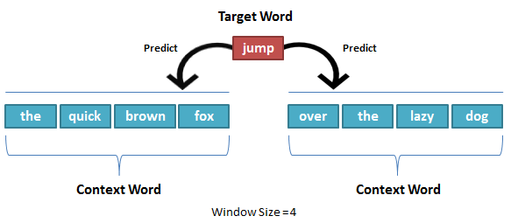
Word2vec
The quick brown fox jumped over the lazy dog.

Slide 6
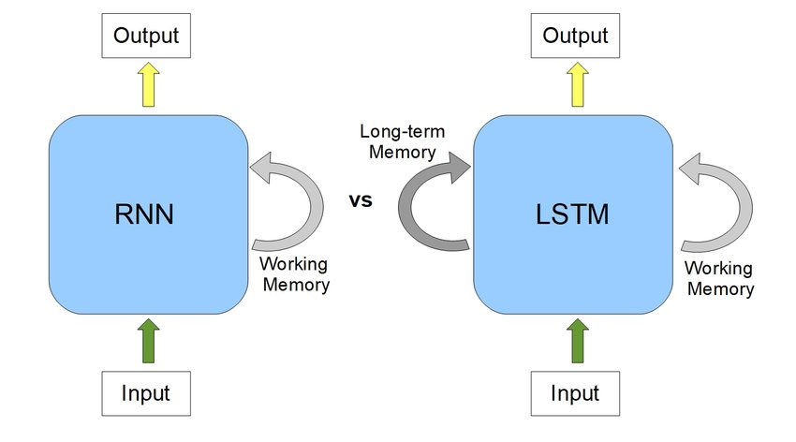
RNN/LSTM

Slide 7
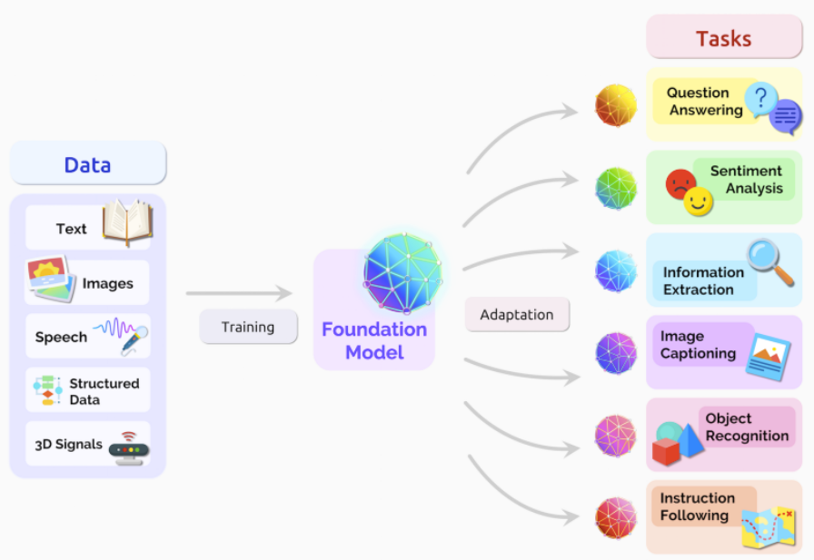
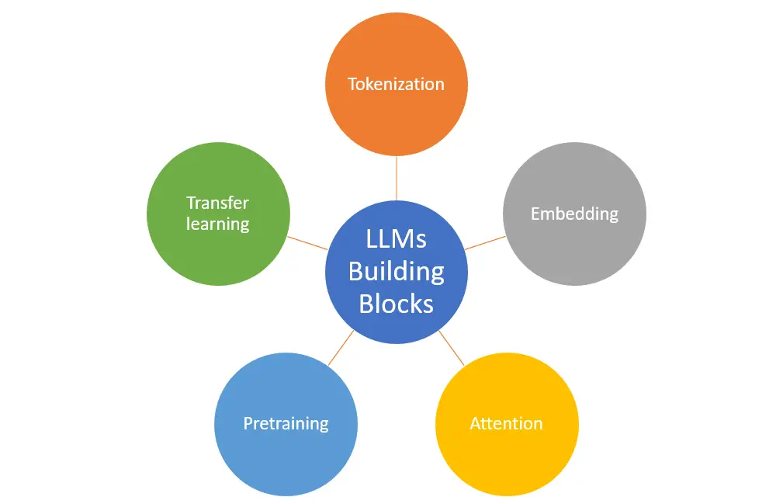
Large Language Models

Slide 8
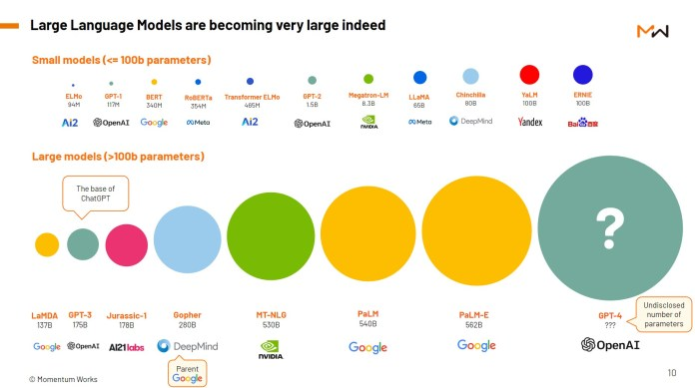

Slide 9
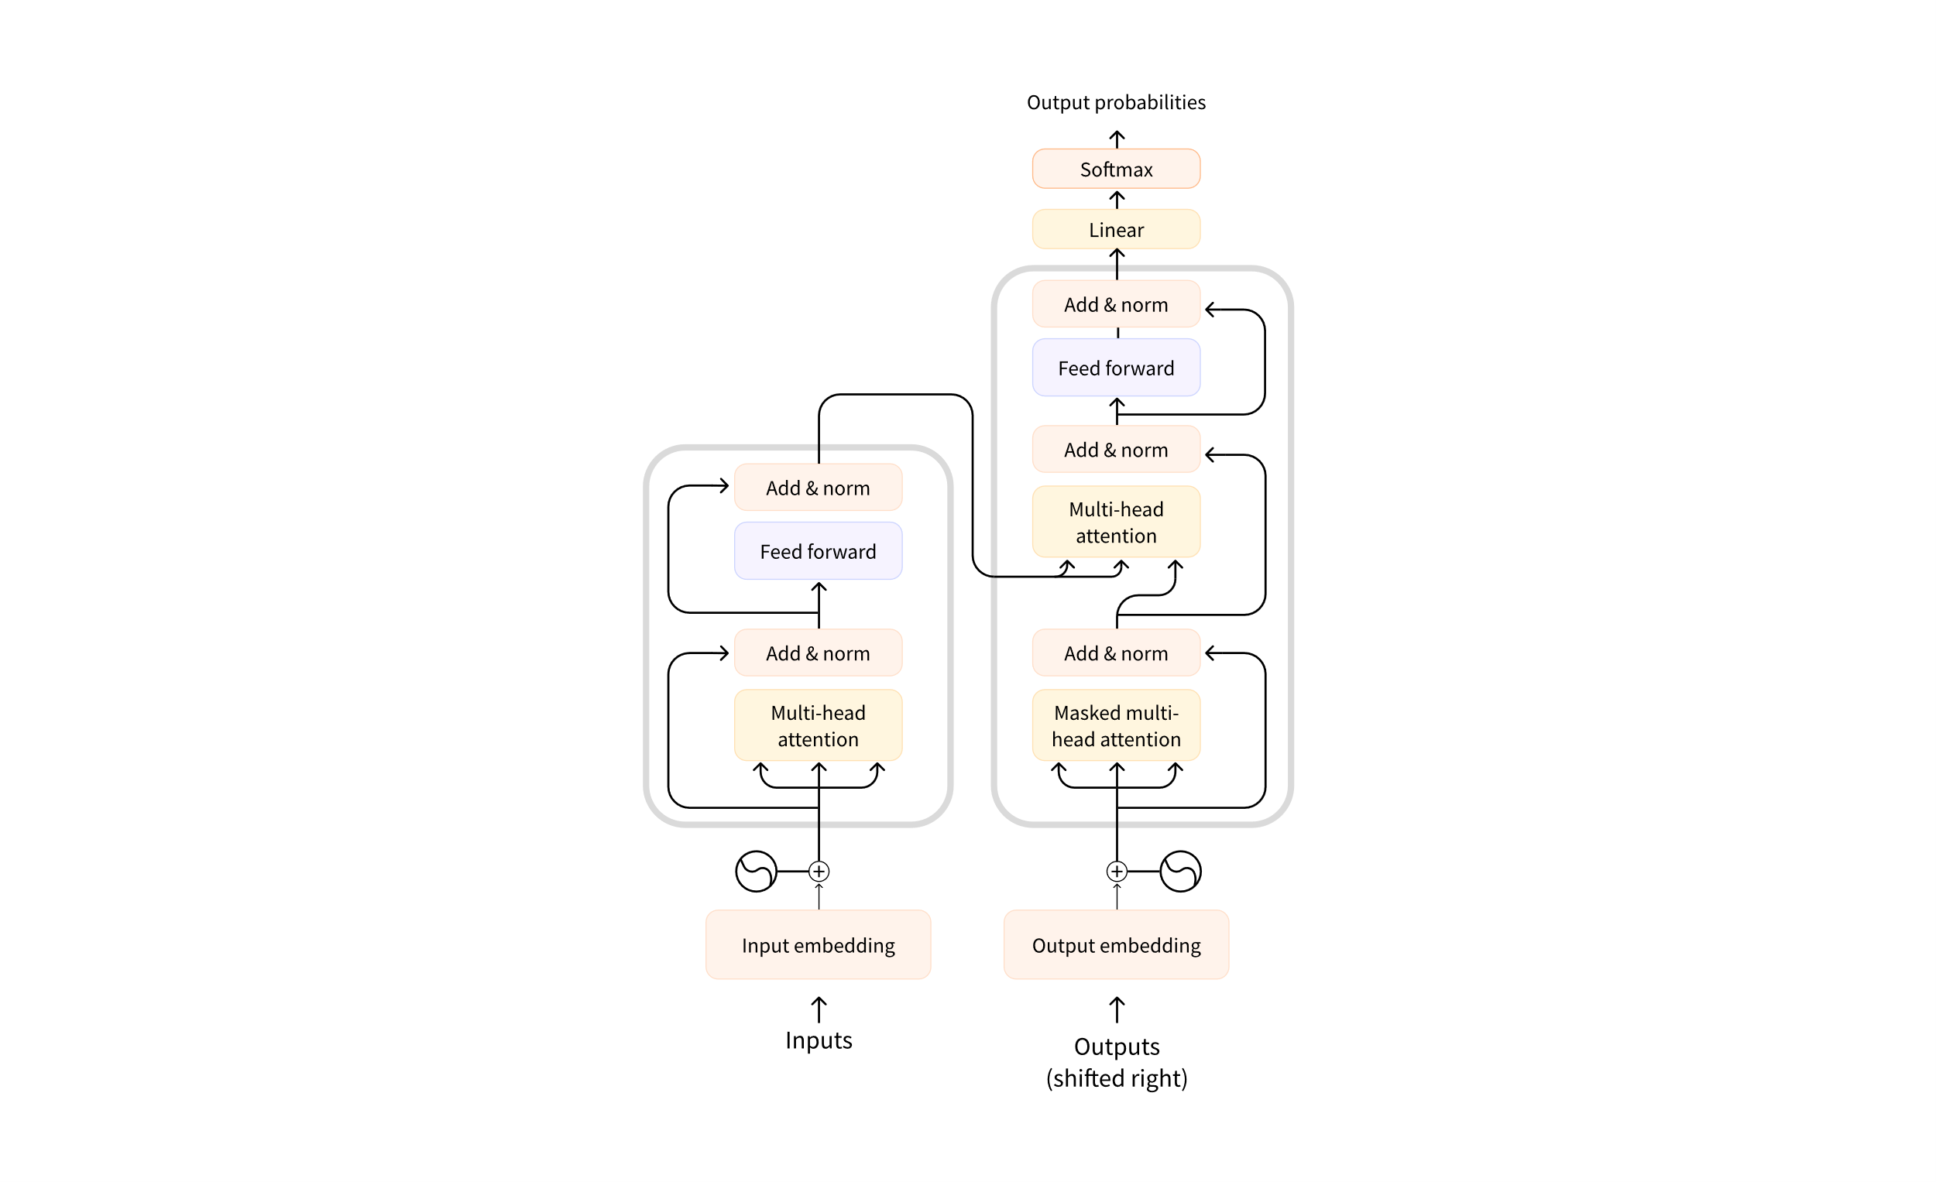
Transformer Architecture

